Slide 1
Partical Repair
Contractor: Example Contractor
Client: Example Client
Agreement #111-11-11 dated 01.11.2024
Structure type F6
Construction count: 2 pcs.
Installation address: Sample District, Example Street 137A, pedestrian area
Reporting period: 01.12.2024-31.12.2024

Slide 2
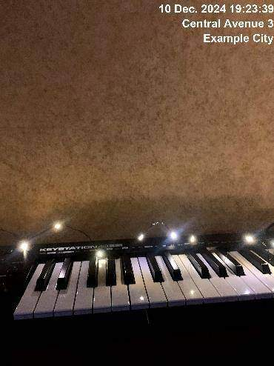
10.12.2024
Construction 1
Issue detected. Partical repair required

Slide 3
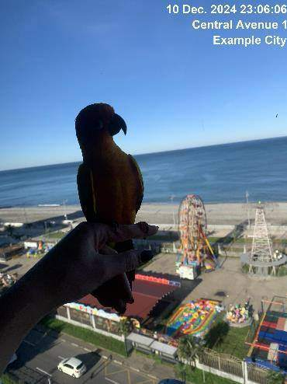
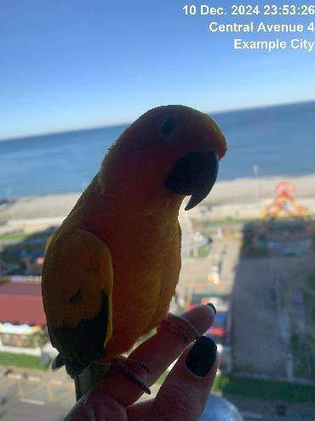
10.12.2024
Construction 1
Partial repair completed

Slide 4
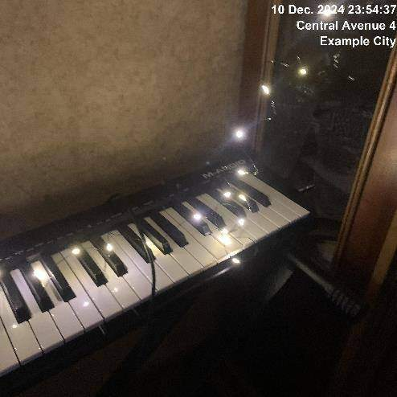
10.12.2024
Construction 1
Issue resolved

Slide 5
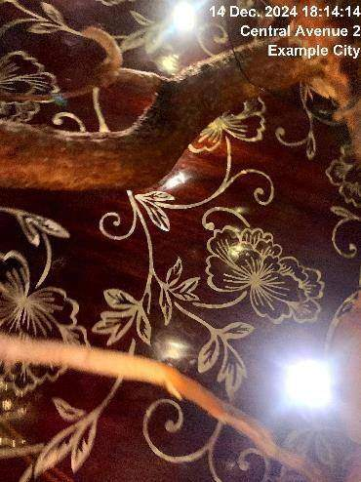
14.12.2024
Construction 3
Issue detected. Partical repair required

Slide 6
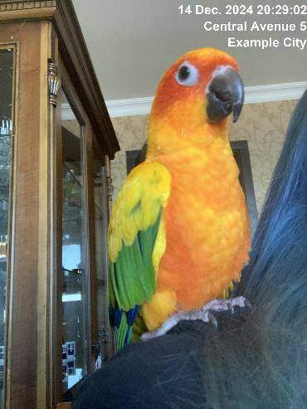
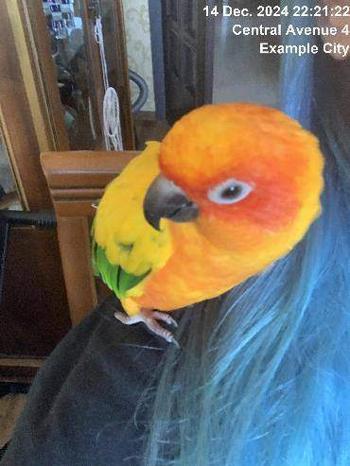
14.12.2024
Construction 3
Partial repair completed

Slide 7

14.12.2024
Construction 3
Issue resolved

Slide 8
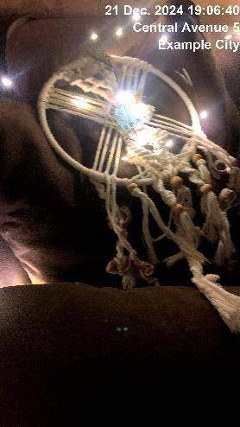
21.12.2024
Construction 2
Issue detected. Partical repair required

Slide 9
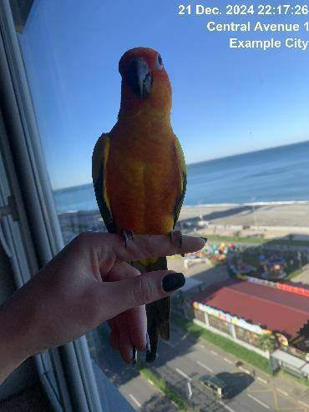
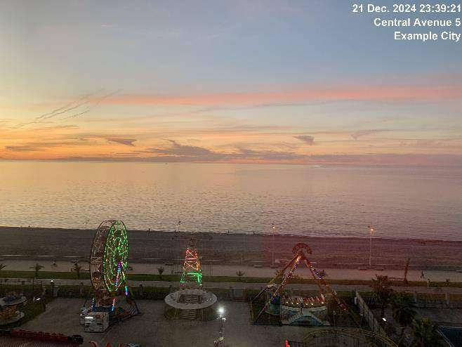
21.12.2024
Construction 2
Partial repair completed

Slide 10
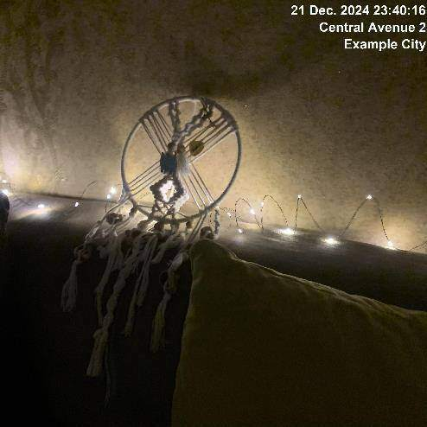
21.12.2024
Construction 2
Issue resolved

